Slide 2
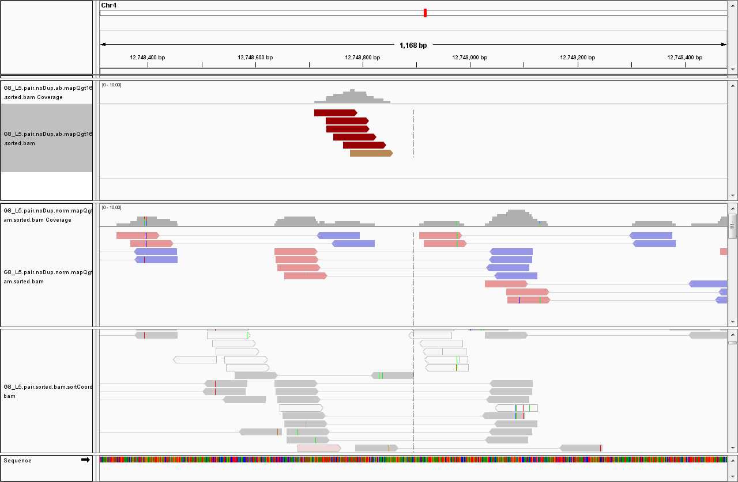
G8_L5 vs G8 (wild cucumber): should be filtered
FF, inversion

Slide 3
SV format
Reference genome
a
b
c
d
Left window | start | end | Read strand | Right window | start | end | Read strand | # abnormal pairs | Abnormal read names | SV type
Chr1 | a | b | R | Chr1 | c | d | F | 4 | (read_1_ID,read_2_ID, read_3_ID, read_4_ID) | LARGE_DUPLI

Slide 4
Col 1 | Col 2 | Col 3 | Col 4 | Col 5 | Col 6 | Col 7 | Col 8 | Col 9 | Col 10 | Col 11
Left window | start | end | Read strand | Right window | start | end | Read strand | # abnormal pairs | Abnormal read names | SV type
Chr1 | 884221 | 884482 | F | Chr1 | 886071 | 886334 | R | 6 | (FC42CA5AAXX:5:11:543:682#0,FC42CA5AAXX:5:64:1039:1736#0,FC42CA5AAXX:5:101:756:1378#0,FC42CA5AAXX:5:27:368:1230#0,FC42CA5AAXX:5:67:1294:1624#0,FC42CA5AAXX:5:67:1013:1526#0) | DELETION
Chr1 | 4848936 | 4849026 | F | Chr1 | 4849100 | 4849192 | R | 3 | (FC42CA5AAXX:5:49:1425:1866#0,FC42CA5AAXX:5:86:40:593#0,FC42CA5AAXX:5:61:952:324#0) | INSERTION
Chr1 | 7982107 | 7982236 | F | Chr1 | 8306788 | 8306875 | F | 3 | (FC42CA5AAXX:5:93:309:1029#0,FC42CA5AAXX:5:97:1689:75#0,FC42CA5AAXX:5:90:254:1603#0) | INVERSION
Chr1 | 7029817 | 7029909 | R | Chr1 | 7032304 | 7032391 | F | 4 | (FC42CA5AAXX:5:25:1733:937#0,FC42CA5AAXX:5:28:736:1157#0,FC42CA5AAXX:5:52:474:918#0,FC42CA5AAXX:5:120:442:1038#0) | LARGE_DUPLI
Scaffold003056 | 154 | 247 | (F,F,F,F),(R,R,R) | Chr4 | 12428408 | 12429258 | (R,R,R,R),(F,F,F) | 7 | (FC42CA5AAXX:5:104:145:741#0,FC42CA5AAXX:5:31:1292:1844#0,FC42CA5AAXX:5:10:97:1351#0,FC42CA5AAXX:5:55:57:59#0),(FC42CA5AAXX:5:90:883:589#0,FC42CA5AAXX:5:113:733:1143#0,FC42CA5AAXX:5:25:1738:1126#0) | TRANSLOC

Slide 5
awk 'BEGIN{FS = "\t"; OFS = "\t";}{print $1,$2,$3,$9,$4,$5,$6,$10,$7, $8, $17}' 3sv.simple | sed 's/,//' | sed 's/,//' > G8_L5.3sv.fmt.ip

Slide 6
Gap filter
fmt.svFilterDelNNNNNN.2 G8_L5.3sv.fmt.ip cucumber_genome 1 -0.1
Cucumber_genome: genome sequence in FASTA format.
If Num_of_N in SV region >= 1 && Num_of_N / SV_length >= -0.1, then this SV is removed.
Result: retained SVs are written to the file G8_L5.3sv.fmt.ip.DELnnn.filt

Slide 7
Norm-ab-ratio filter
fmt.normal-abnom-ratio-window.2.useMap G8_L5.3sv.fmt.ip.DELnnn.filt G8_L5.pair.noDup.norm.mapQgt16.sam 0.2 75
Normal PE SAM file
If Norm_reads / abnorm_reads > 0.2, then the SV is removed
75: read length
Result: kept SVs written to G8_L5.3sv.fmt.ip.DELnnn.filt.normPair.filt

Slide 8
Snp filter
script-snp-filt G8_L5.3sv.fmt.ip.DELnnn.filt.normPair.filt cucumber_genome cucumber_genome.fai
cucumber-chr-inOrder G8_L5.pair.noDup.ab.mapQgt16.sam G8_L5.pair.noDup.norm.mapQgt16.sam
2
cucumber-chr-inOrder
Chr1
Chr2
Chr3
Chr6
Chr7
Scaffold000001_6
……
Scaffold012707
Chr4
Chr5
Abnormal and normal PE SAM files
2: read coverage for snp detection

Slide 9
Algorithm paper
Pindel
G8_L5 vs. chinese long
871 deletions (including 18 deletions located in scaffolds) G8_L5-pindel-soft_D.simple wwz server
772 (including scaffolds) deletions kept after gap filter

Slide 10
Algorithm paper; Pindel; G8_L5 vs. Chinese long
9 deletions: 100% of deletion region are N
80 NNNinDel Chr1 12286609 12286609 Chr1 12286683 12286683 F, R, UNBAL 73 73 1
81 NNNinDel Chr1 14084779 14084779 Chr1 14085045 14085045 F, R, UNBAL 265 265 1
339 NNNinDel Chr3 23788743 23788743 Chr3 23788864 23788864 F, R, UNBAL 120 120 1
466 NNNinDel Chr6 11620455 11620455 Chr6 11620551 11620551 F, R, UNBAL 95 95 1
469 NNNinDel Chr6 13716561 13716561 Chr6 13716663 13716663 F, R, UNBAL 101 101 1
476 NNNinDel Chr6 19292122 19292122 Chr6 19292291 19292291 F, R, UNBAL 168 168 1
478 NNNinDel Chr6 19716626 19716626 Chr6 19716836 19716836 F, R, UNBAL 209 209 1
774 NNNinDel Chr5 5105098 5105098 Chr5 5105232 5105232 F, R, UNBAL 133 133 1
871 NNNinDel Chr5 27906842 27906842 Chr5 27906893 27906893 F, R, UNBAL 50 50 1

Slide 11
Genome-wide identification of genetic variations (SNP & indel & SV) in > 100 watermelon lines
Evolution
Domestication
Allele discovery

Slide 12
Algorithms
Using PI (wild cucumber) genome assembly as a “Golden Standard” to optimize SNP & SV detection algorithms and parameters
SNP
PE mapping
1. raw reads -> remove duplicates (both read identical)
2. trim adaptor & low quality (remove read pair; trim part of reads)
3. bwa aln (sai)
PE mapping parameters for identical read lengths
read_len param
44(bp) -n 1 -o 1 -e 0
75(bp) -n 2 -o 1 -e 1
90(bp) -n 2 -o 1 -e 1
4. PE mapping
4.5 rm repetitivr hits (?)
5. samtools mpileup -Q 30 (?) -q 17 -d 1000000 -f $ref $dir-all.sorted.bam
Chr1 110803 A 0
6. reSeqPrintSample.indel.fast.strAssign (penguin server) ../../S_lycopersicum_chromosomes.2.40.fa
sample-speciesA-1column pileup-file speciesA 2 2 0.3
1-column genotype for speciesA
7. reSeqPrintRefChr to generate ref info (3 columns: chr1 123 A)

Slide 13
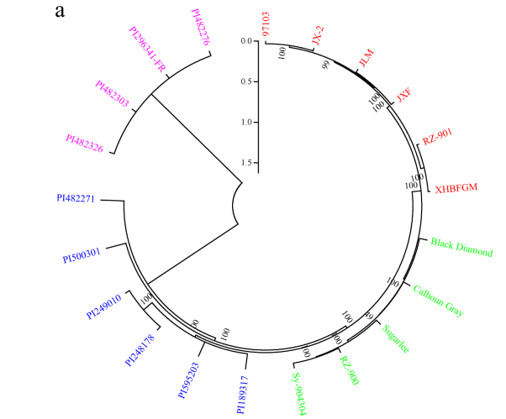
Using SNP & SV to build the tree
Guo, S., et al. (2013) The draft genome of watermelon (Citrullus lanatus) and resequencing of 20 diverse accessions, Nat Genet, 45, 51-58.
Notes:
Figure 3 Population structure and genetic diversity across watermelon accessions. (a) Neighbor-joining phylogenetic tree of watermelon accessions based on SNPs.
The posterior probabilities (credibility of the topology) for inner nodes are all 100%.
In these analyses, we used a subset of ~1.46 million SNPs that had information in all 21 watermelon accessions. A neighbor-joining tree was constructed using PHYLIP (http://evolution.genetics.washington.edu/phylip.html) and MEGA5 (ref. 70) was used to display the tree.

Slide 14
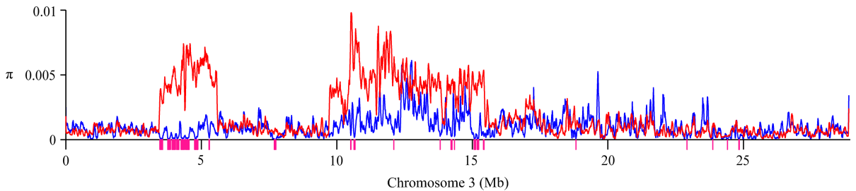
Using SNP to detect selective sweeps. Identify SVs associated with the selective sweeps.
semi-wild
cultivated
Selective sweeps due to domestication selection.
Enriched in biological processes related to fruit traits (e.g. sugar mediated signaling, carbohydrate metabolism, regulation of nitrogen compound metabolism)
Guo, S., et al. (2013) The draft genome of watermelon (Citrullus lanatus) and resequencing of 20 diverse accessions, Nat Genet, 45, 51-58.
Notes:
(d) Nucleotide Diversity (π) distribution for C. lanatus subsp. vulgaris (blue) and C.lanatus subsp. mucosospermus (red) across the chromosome 3. For all 11 chromosomes see Supplementary Figure 13. Pink bars below x-axis correspond to regions with 1% significance level of diversity difference (πmucosospermus/πvulgaris). These regions represent potential selective sweeps due to domestication selection.
A sliding window approach was used to calculate the θw and π along all eleven watermelon chromosomes with a window size of 50 kb and a step size of 10 kb.

Slide 15
Using wild watermelon as a reference, find SVs in cultivated watermelons.
Genes present in wild watermelon but lost during the course of domestication
Association of SNP & SVs with phenotypes
Sugar content
Fruit color

Slide 16
SNP & indel detection algorithm – prepare Golden standard
For each 10-kbp region, retrieve 1st 1001-bp sequence from the PI assembly (37267 sequences, 1001-bp each)
Using bwa bwasw (default parameter)to map 1001-bp sequences to the 97103 genome
Only select sequences that are
< 200bp soft clipping (29058 retained)
> 95% sequence identity (20114 retained)
Alignment score > 800 (18163 retained)
Generate pileup file
Discard sites with coverage >= 2 in the pileup file (17,675,409 -> 17,652,670)
Generate genotype file

Slide 17
SNP & indel detection algorithm – short read mapping
Data: XG26_1_clean.fq, 101bp, PE, 433-bp insert size, 69,260,369 pairs (after removing duplcate pairs)
Using PE mapping
First, remove duplicated pairs by Honghe’s perl program (2,321,533 pairs dropped)
“-n 3 -o 1 -e 2 “ used for mapping
False positive snp calling (0.36%)
True SNP (268862) – SNP called by short reads; Identical genotypes beweent short reads and 1001-bp sequence
False SNP (961) - SNP called by short reads; But 1001-bp has same genotype as reference
False negative (2.62%)
Total SNPs called by 1001-bp sequences (282281)
Missed SNPs (7403) – genotype by short reads is same as reference or ‘N’ (short read ‘N’: 2259)

Slide 18
SNP & indel detection algorithm – short read mapping
Data: XG26_1_clean.fq, 101bp, PE, 433-bp insert size, 69,260,369 pairs
False positive snp calling (0.36%)
True SNP (268862) – SNP called by short reads; Identical genotypes beweent short reads and 1001-bp sequences
False SNP (961) - SNP called by short reads; But 1001-bp has same genotype as reference
False negative (2.62%)
Total SNPs called by 1001-bp sequences (282281)
Missed SNPs (7403) – genotype by short reads is same as reference or ‘N’ (short read being ‘N’: 2259; same as ref: 5144)
Notes:
5144 / 274183 = 1.88%
linyong@boyce:watermelon-reseq$ awk '$5 != $3' temp.noN.ACGT | wc -l
274183
linyong@boyce:watermelon-reseq$ awk '$5 != $3 && ($4 == $3)' temp.noN.ACGT | wc -l
5144

Slide 19
SNP & indel detection algorithm – short read mapping
Data: XG26_1_clean.fq, 101bp, PE, 433-bp insert size, 69,260,369 pairs
Using cleaned reads to detect SNP & indel
Raw reads: 13,990,594,538 bp
After cleaning: 11,842,645,162 bp
False positive snp calling (0.45 %)
True SNP (268258) – SNP called by short reads; Identical genotypes beweent short reads and 1001-bp sequences
False SNP (1222) - SNP called by short reads; But 1001-bp has same genotype as reference
False negative (2.99%)
Total SNPs called by 1001-bp sequences (282281)
Missed SNPs (8431) – genotype by short reads is same as reference or ‘N’ (short read being ‘N’: 3396; same as ref: 5035)

Slide 20
SNP & indel detection algorithm – short read mapping
Data: reseq (nature genetics published) data , 44 bp, PE,
Using -Q 30 -q 17 -d 2000 (decided by Honghe. I used -Q 0 -d 1000000)
False positive snp calling (0. 57 %)
True SNP (217216) – SNP called by short reads; Identical genotypes beweent short reads and 1001-bp sequences
False SNP (1247) - SNP called by short reads; But 1001-bp has same genotype as reference
False negative (?%)
Total SNPs called by 1001-bp sequences (282281)
Missed SNPs (62900) – genotype by short reads is same as reference or ‘N’ (short read being ‘N’: 58709; same as ref: 4191)
Ref, short-, 1001-bp, all call A/C/G/T False negative 4191 / 221462 = 1.89%
$ awk '$5 != $3' temp.noN.ACGT | wc -l
221462
linyong@boyce:watermelon-reseq$ awk '$5 != $3 && ($4 == $3)' temp.noN.ACGT | wc -l
4191

Slide 21
PI (wild watermelon) vs 97103
Snp | 282281 | 1.60%
Indel (1001bp mapping, some deletion very long) | 85744 | 0.49%
Total bp (temp.Q0.c1.pileup, 1001-bp from PI genome) | 17652670

Slide 22
102 watermelon accessions resequenced
paste ref.3colum /home/Sunhh/WM_Reseq/Final_Raw/*/*.1col > temp-102-acc.table &
nohup snp-table-filter.2 temp-102-acc.table wm-102acc-snp.noMiss.table 0.999999 &
script-cut-1-colum (wwz server)
script-colum-2-fasta ### each column -> each fasta file
java -cp ~/bin/readseq.jar run -informat=8 -f 17 wm-102acc-snp.noMiss.faseq # fasta -> nexus format)

Slide 23
102 watermelon accessions resequenced
SNP/indel identification pipeline (raw reads, remove duplicated read pairs, PE mapping, genotype calling)
Honghe has run all 102 accessions
SNP calling false positive and false negative rate < 1% (comparing 97103 reference genome with PI296341-FR assembled genome)
814,730 SNPs in 103 accessions (including 97103)
All 103 accessions have genotype information
No indels
At least 2 accessions have different genotypes
However, if excluding PI386019 (colocynthis), only 175,450 SNPs remained in 102 accessions

Slide 24
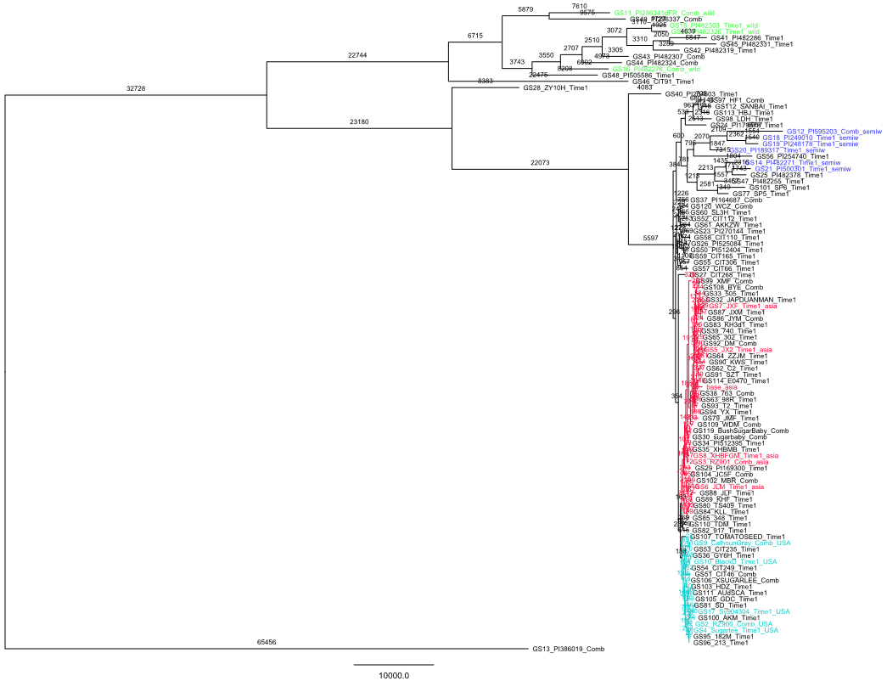
Root branch length 654569

Slide 25
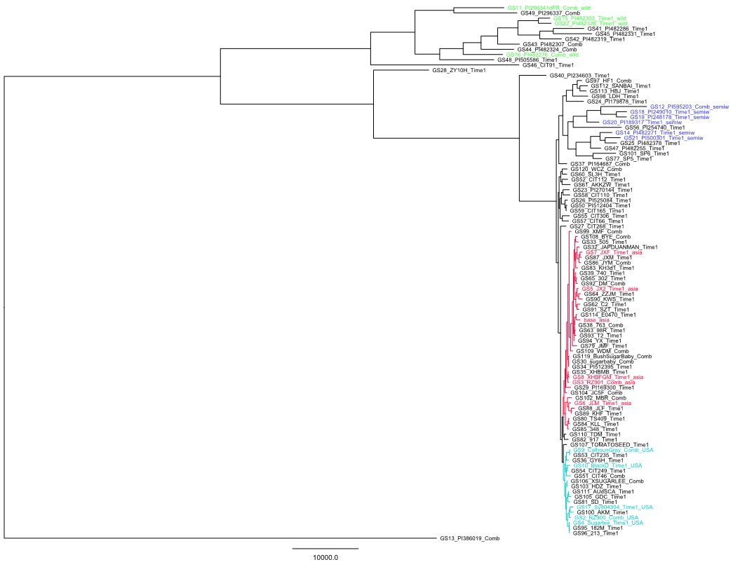

Slide 26
wm_reseq.rmClose_4DTv_mis00_mafR05_rmHete.snp​

Slide 27
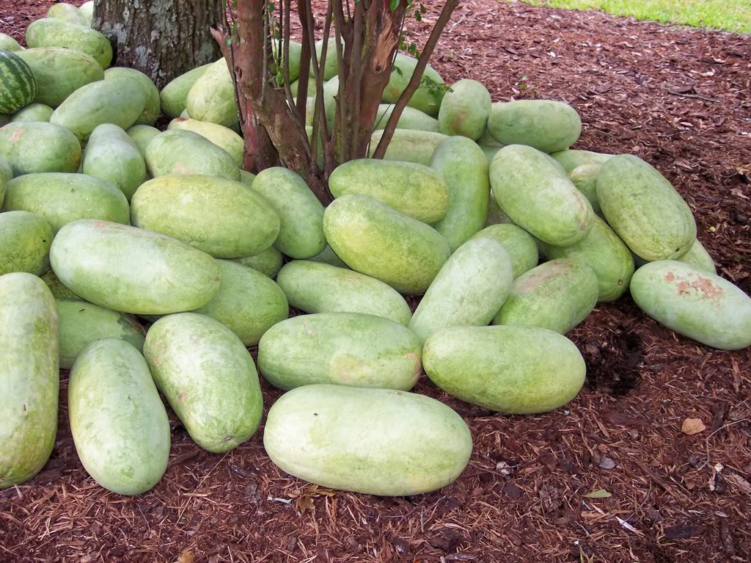
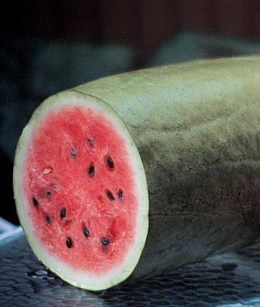
Gene loss / gain in Charleston gray relative to 97103
Large 28-35 lb. cylindrical watermelons.
Flesh is red, crisp, fiberless and delicious; skin is light greenish gray. Resistant to fusarium wilt, anthracnose and sunburn. Ready for harvest 85 days after sowing.

Slide 28
 | Charleston gray | 97103
Fruit Shape | Cylindrical | Round
Fruit Size | Large | Medium
Flesh color | red | Light red
Skin color | gray-green | green
rind | Medium thick | thin

Slide 29

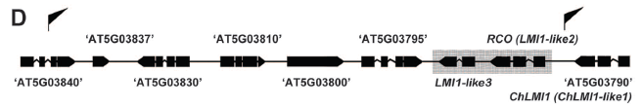
Leaf Shape Evolution Through Duplication, Regulatory Diversification, and Loss of a Homeobox Gene
Science 14 February 2014: Vol. 343 no. 6172 pp. 780-783
An A. thaliana (left) and
C. hirsuta (right) plant
Although its ancestors had all three genes, A. thaliana lost two of them during its evolution, leaving it with only LMI1. ... a simple leaf with a single blade

Slide 30
Charleston gray PE libraries
 |  |  | raw reads | mapped reads | mapped reads | unique reads | unique reads | non-dup reads | non-dup reads
R2_s_1_1_sequence.txt | 100(bp) | -n 4 -o 1 -e 2 | 24441905 | 21292186 | 87.11% | 19014406 | 77.79% | 16649900 | 68.12%
R2_s_1_2_sequence.txt | 100(bp) | -n 4 -o 1 -e 2 | 24441905 | 19591044 | 80.15% | 17576932 | 71.91% | 15508237 | 63.45%
R2_s_2_1_sequence.txt | 100(bp) | -n 4 -o 1 -e 2 | 24810490 | 21594564 | 87.04% | 19275199 | 77.69% | 16809936 | 67.75%
R2_s_2_2_sequence.txt | 100(bp) | -n 4 -o 1 -e 2 | 24810490 | 20082623 | 80.94% | 17987617 | 72.50% | 15775784 | 63.59%
s_1_1_sequence.txt | 100(bp) | -n 4 -o 1 -e 2 | 34399824 | 29956032 | 87.08% | 26763045 | 77.80% | 23208006 | 67.47%
s_1_2_sequence.txt | 100(bp) | -n 4 -o 1 -e 2 | 34399824 | 27805573 | 80.83% | 24937235 | 72.49% | 21790938 | 63.35%
s_2_1_sequence.txt | 100(bp) | -n 4 -o 1 -e 2 | 34116634 | 29640194 | 86.88% | 26479870 | 77.62% | 22915279 | 67.17%
s_2_2_sequence.txt | 100(bp) | -n 4 -o 1 -e 2 | 34116634 | 27276717 | 79.95% | 24512159 | 71.85% | 21418057 | 62.78%
s_3_1_sequence.txt | 100(bp) | -n 4 -o 1 -e 2 | 34038316 | 29637407 | 87.07% | 26475622 | 77.78% | 22906419 | 67.30%
s_3_2_sequence.txt | 100(bp) | -n 4 -o 1 -e 2 | 34038316 | 27552186 | 80.94% | 24732816 | 72.66% | 21572498 | 63.38%
s_5_1_sequence.txt | 100(bp) | -n 4 -o 1 -e 2 | 33333984 | 28235134 | 84.70% | 25364180 | 76.09% | 22468872 | 67.41%
s_5_2_sequence.txt | 100(bp) | -n 4 -o 1 -e 2 | 33333984 | 25030483 | 75.09% | 22665914 | 68.00% | 20290190 | 60.87%
s_6_1_sequence.txt | 100(bp) | -n 4 -o 1 -e 2 | 33334498 | 28189927 | 84.57% | 25330928 | 75.99% | 22452456 | 67.36%
s_6_2_sequence.txt | 100(bp) | -n 4 -o 1 -e 2 | 33334498 | 24970502 | 74.91% | 22618347 | 67.85% | 20257741 | 60.77%
s_7_1_sequence.txt | 100(bp) | -n 4 -o 1 -e 2 | 33044008 | 28106946 | 85.06% | 25248395 | 76.41% | 22385702 | 67.75%
s_7_2_sequence.txt | 100(bp) | -n 4 -o 1 -e 2 | 33044008 | 25071874 | 75.87% | 22698902 | 68.69% | 20327280 | 61.52%
8 PE libraries
Raw coverage for 1 PE library: 30 M x 2 x 100 (bp) / 425 Mbp = 14

Slide 31
Charleston gray PE libraries: insert size. Mapped to 97103
 | Insert size | std
R2_s_1.pair.sam | 392 | 44 | 684
R2_s_2.pair.sam | 391 | 44 | 683
s_1.pair.sam | 389 | 44 | 679
s_2.pair.sam | 389 | 44 | 679
s_3.pair.sam | 390 | 44 | 680
s_5.pair.sam | 387 | 43 | 670
s_6.pair.sam | 387 | 43 | 672
s_7.pair.sam | 387 | 43 | 671

Slide 32
Detected deletions in Charleston gray
After 4 filters, 8.4% of deletions were retained
n- parameter | 50% | del: 50% N as cutoff; ins/inv: no N; dup: N- filter not used
norm pair | 0.2
snp | 2 reads
pileup | 5%

Slide 33
Clustering SVs which were detected over 8 libraries
323 deletions (n- filter: 50%)
91 (28%) detected in only 1 library
39 detected in all 8 libraries
Mean: 1043 bp / deletion
A total of 336832-bp deletions
7 inversions (n-filter: any gap filtered out)
5 detected in single library, 1 in three libraries, 1 in five libraries
10 tandem duplications
3 detected in single library, 2 detected in three libraries, 5 in all eight libraries
 | Individual library | Combining all 8 libraries to detect SVs (increasing coverage)
Deletion | 323 | 345
Inversion | 7 | 7
Tandem duplication | 10 | 11

Slide 34
 | trait | Left mark | Left marker for 1-LOD support interval in original map | Right marker for 1-LOD support interval in original map |  |  |  | QTL interval
10 | FSI | NW0250598 | NW0250299 | NW0249853 | Chromosome 10 | 11,788,499 | 14,456,572 | 2,668,073
2 | FSI | NW0248056 | NW0248574 | NW0249974 | Chromosome 2 | 29,344,332 | 31,964,968 | 2,620,636
3 | FSI | NW0248107 | NW0248107 | NW0250956 | Chromosome 3 | 25,980,598 | 26,945,334 | 964,736
3 | FSI | NW0248599 | NW0248107 | NW0250956 | Chromosome 3 | 25,980,598 | 27,088,808 | 1,108,210
3 | FSI | NW0249365 | NW0248107 | NW0250956 | Chromosome 3 | 25,980,598 | 26,945,334 | 964,736
2 | FWT | NW0248650 | NW0251187 | NW0248460 | Chromosome 2 | 13,296,568 | 23,463,401 | 10,166,833
2 | FWT | NW0250803 | NW0250803 | NW0249789 | Chromosome 2 | 15,402,415 | 19,145,199 | 3,742,784
2 | FWT | NW0249226 | NW0249185 | NW0248574 | Chromosome 2 | 28,236,187 | 29,344,452 | 1,108,265
2 | FWT | NW0248254 | NW0249185 | NW0249883 | Chromosome 2 | 28,236,187 | 30,555,474 | 2,319,287
5 | FWT | NW0250460 | NW0250483 | NW0252517 | Chromosome 5 | 4,754,110 | 6,976,641 | 2,222,531
5 | FWT | NW0251335 | NW0251335 | NW0248177 | Chromosome 5 | 25,424,286 | 26,204,529 | 780,243
3 | FWT | NW0248648 | NW0248648 | NW0248282 | Chromosome 3 | 10,154,278 | 20,689,338 | 10,535,060
fruit weight (FWT), fruit length (FL), fruit width (FWD), fruit shape index (FSI),
An integrated genetic map based on four mapping populations and quantitative trait loci associated with economically important traits in watermelon (Citrullus lanatus); Ren et al. BMC Plant Biology 2014, 14:33

Slide 35
SV |  |  |  | Sv size | trait | QTL start | QTL end | QTL interval
Chr2 | 18,599,586 | 18,600,240 | DELETION | 654 | FWT | 15,402,415 | 19,145,199 | 3,742,784
Chr2 | 16,542,609 | 16,543,106 | DELETION | 497 | FWT | 15,402,415 | 19,145,199 | 3,742,784
Chr2 | 17,998,556 | 17,999,715 | DELETION | 1159 | FWT | 15,402,415 | 19,145,199 | 3,742,784
Chr2 | 15,572,848 | 15,574,071 | DELETION | 1223 | FWT | 15,402,415 | 19,145,199 | 3,742,784
Chr2 | 17,401,354 | 17,402,379 | DELETION | 1025 | FWT | 15,402,415 | 19,145,199 | 3,742,784
Chr2 | 28,592,501 | 28,592,866 | DELETION | 365 | FWT | 28,236,187 | 29,344,452 | 1,108,265
Chr2 | 30,110,279 | 30,111,646 | DELETION | 1367 | FWT | 28,236,187 | 30,555,474 | 2,319,287
Chr2 | 28,592,501 | 28,592,866 | DELETION | 365 | FWT | 28,236,187 | 30,555,474 | 2,319,287
Chr5 | 4,786,251 | 4,786,676 | DELETION | 425 | FWT | 4,754,110 | 6,976,641 | 2,222,531
Chr5 | 6,006,528 | 6,006,843 | DELETION | 315 | FWT | 4,754,110 | 6,976,641 | 2,222,531
Chr5 | 5,242,371 | 5,242,720 | DELETION | 349 | FWT | 4,754,110 | 6,976,641 | 2,222,531
Chr3 | 10,300,658 | 10,316,774 | LARGE_DUPLI | 16116 | FWT | 10,154,278 | 20,689,338 | 10,535,060
Chr3 | 13,598,957 | 13,608,351 | LARGE_DUPLI | 9394 | FWT | 10,154,278 | 20,689,338 | 10,535,060
46 deletions (out of 345), 2 inversions (7), 2 duplications (11) in FWT QTL regions

Slide 36
BRX | Chr1 | 31417282 | 32481439 | Chr1 | 32426945 | 32427161 | DELETION | Cla009730, 217-bp intron deletion GO:0016702 - oxidoreductase activity, acting on single donors with incorporation of molecular oxygen, incorporation of two atoms of oxygen GO:0050474 - (S)-norcoclaurine synthase activity GO:0005506 - iron ion binding GO:0045431 - flavonol synthase activity GO:0031418 - L-ascorbic acid binding GO:0016829 - lyase activity GO:0046872 - metal ion binding GO:0009815 - 1-aminocyclopropane-1-carboxylate oxidase activity GO:0016491 - oxidoreductase activity
FWT | Chr2 | 13296568 | 23463401 | Chr2 | 15122624 | 15129954 | INVERSION | Cla002116 , exon 6,7,8 inverted GO:0030301 - cholesterol transport GO Molecular Function GO:0008158 - hedgehog receptor activity GO Cellular Component GO:0016020 - membrane GO:0016021 - integral to membrane

Slide 37
Watermelon sv annotation perl programs
perl add_gene.pl watermelon_v1.gff > add_watermelon_v1.gff
perl sv_gff3_watermelon.pl -i temp-table -g add_watermelon_v1.gff -s sort_watermelon -p 2000 -o water_out ### temp-table 14 columns

Slide 38
Reference genome size | 355,247,419
Statistics Based on the pileup file
covered positions by at least 1 read | 314,302,476 | 88.4742%
covered pos by at least 5 reads | 313,082,945
covered pos by less than 5 reads | 1,219,531
 |  | Divided by [covered pos by at least 5 reads]
M | 219,933 | 0.0702%
I (insertion) | 10,956 | 0.0035%
D (deletion) | 18,017 | 0.0058%

Slide 39
Apple resequencing
B |  | 2
V |  | 3
H |  | 10
D |  | 12
S | {CG} | 121,597
K | {GT} | 241,945
M | {AC} | 242,040
W | {AT} | 298,483
R | {AG} | 688,994
Y | {CT} | 689,641
G |  | 72,714,248
C |  | 72,772,769
A |  | 119,964,919
T |  | 119,984,176
N |  | 222,152,194
total(exclude N) |  | 387,718,839
total(dinucleotide heter) |  | 2,282,700 | 0.005888
chr10 38388735
chr11 40097135
chr12 36276390
chr13 39686181
chr14 34156359
chr15 55775544
chr16 23462993
chr17 27122625
chr1 36084770
chr2 40172906
chr3 39907702
chr4 25412026
chr5 37603955
chr6 30670535
chr7 31181134
chr8 35800839
chr9 37514189
Malus_domestica_chloroplast_genome 160068
Malus_domestica_mitochondrial_genome 396947
Non-A/C/G/T bases on the ref genome are converted to random nucleotides.

Slide 40
Sample ID | # of fq files
101 | 2
94 | 2
96 | 2
100 | 4
102 | 4
104 | 4
105 | 4
106 | 4
107 | 4
108 | 4
113 | 4
123 | 4
74 | 4
77 | 4
78 | 4
80 | 4
81 | 4
84 | 4
85 | 4
86 | 4
87 | 4
88 | 4
89 | 4
90 | 4
93 | 4
97 | 4
98 | 4
99 | 4
1st batch of apple reseq. Data by BGI
28 samples
106 fq files
130928_I232_FCC2V36ACXX_L1_SZAIPI032948-113_1.fq.gz
130928_I232_FCC2V36ACXX_L1_SZAIPI032948-113_2.fq.gz
130928_I232_FCC2V36ACXX_L2_SZAIPI032948-113_1.fq.gz
130928_I232_FCC2V36ACXX_L2_SZAIPI032948-113_2.fq.gz

Slide 41
sampleID | read-90bp-mapped-550of1000-align-ident | bwa-NM | #-of-reads-90bp-mapped
99 | 92.39 | 6 | 583
123 | 93.55 | 5 | 589
100 | 94.44 | 5 | 594
105 | 94.44 | 5 | 610
102 | 94.44 | 5 | 615
113 | 94.44 | 5 | 615
108 | 94.44 | 5 | 617
101 | 95.56 | 4 | 623
97 | 95.56 | 4 | 657
106 | 95.56 | 4 | 640
86 | 96.67 | 3 | 687
78 | 96.67 | 3 | 693
93 | 96.67 | 3 | 673
94 | 96.67 | 3 | 682
98 | 96.67 | 3 | 685
104 | 96.67 | 3 | 673
107 | 96.67 | 3 | 657
80 | 96.7 | 3 | 678
81 | 96.7 | 3 | 697
88 | 96.7 | 3 | 687
96 | 96.74 | 3 | 670
87 | 97.78 | 3 | 684
90 | 97.78 | 3 | 698
74 | 97.78 | 3 | 687
77 | 97.78 | 3 | 697
85 | 97.78 | 3 | 682
89 | 97.78 | 3 | 687
84 | 97.78 | 3 | 131
Set bwa edit distance parameter such that at least 55% of reads can be mapped
For each sample, randomly select 1000 90-bp reads (choose 1 read per 120k sequences). Blast 1000 reads against apple ref. genome
Count how many reads that are 90-bp aligned
550th read’s identity
Determine edit distance (-NM) for bwa mapping
Using more relaxed bwa alignment parameters for more remotely related species.
Assume that 55% reads should be able to be aligned to the ref genome.
No contaminations.
Since whole read (90-bp) was mapped, no adaptor / barcode in the read;
These 550 mapped reads be random. (20% reads identity 100% ; 15% reads id 99%; 10% reads id. 98%, … ,92% , …, until 1e-15)
200 reads contaminated.
800 reads non contaminated.
550/800 reads mapped.

Slide 42
SNP pipeline
Remove PE duplicates
Paired-end alignment
Merge bam files
Pileup
Genotype calling
samtools mpileup -q , using 17 or 20?
200 pairs of reads (at least 1 read unique, NM = 3)
104 reads with mapQ = 17; 29 reads with mapQ = 25

Slide 43
awk '$5 == 17' redu.sam | grep -o XM:i:[0-9]* | sort | uniq -c
465
----------------------
20 XM:i:0
24 XM:i:1
7 XM:i:10
3 XM:i:11
2 XM:i:12
2 XM:i:13
2 XM:i:14
3 XM:i:15
1 XM:i:16
1 XM:i:18
24 XM:i:2
238 XM:i:3
37 XM:i:4
37 XM:i:5
32 XM:i:6
18 XM:i:7
9 XM:i:8
5 XM:i:9
awk '$5 == 25' redu.sam | grep -o XM:i:[0-9]* | sort | uniq -c
167
----------------------
10 XM:i:0
13 XM:i:1
12 XM:i:2
132 XM:i:3
awk '$5 >= 20' redu.sam | grep -o XM:i:[0-9]* | sort | uniq -c
7562
----------------------
3610 XM:i:0
1997 XM:i:1
7 XM:i:10
3 XM:i:11
1 XM:i:12
1 XM:i:13
1 XM:i:14
3 XM:i:15
1 XM:i:16
1 XM:i:17
1 XM:i:18
1120 XM:i:2
1 XM:i:21
1 XM:i:23
496 XM:i:3
159 XM:i:4
68 XM:i:5
44 XM:i:6
26 XM:i:7
12 XM:i:8
9 XM:i:9
0.28% of mapped reads (orphan reads, abnorm. Paired reads) (XM >= 10)
7898 pairs (15796 reads), 12322 mapped reads

Slide 44
sample | Apple id 74 | Id 99
Raw basee | 14.6 Gbases (7.4 + 7.2) | 13 Gb (6.5 + 6.5)
Genome coverage | 83% | 74% (286,133,031)
Bwa parameter | -n 3 –o 1 (90bp) | -n 6 –o 2
Substitute rate | 2.1M/318M = 0.66% | 5.8M/282M = 2.1%
indel | 0.47M | 0.91M
Heterozygosity | 1.40M / 322M = 0.44% 70466 CG 136008 GT 136266 AC 137081 AT 461020 AG 462298 CT | 2.26M / 286M = 0.79% 116017 CG 216293 GT 217680 AC 247142 AT 731431 CT 733501 AG
Chloroplast substitution rate for id 99: 143 / 108680 = 0.13%
Mitochondrial substitution rate: 217 / 359776 = 0.060 %
awk '$1 != "N" ' 74.q20.1colum | wc -l
321,590,201 (83%)
grep " [ACGT] [ACGT]$" temp.74.q20.4colum > temp.74.q20.4colum.A-A
wc -l temp.74.q20.4colum.A-A
318,175,940 temp.74.q20.4colum.A-A
awk '$3 != $4' temp.74.q20.4colum.A-A | wc -l
2,108,680
awk '$4 == "*" || $4 ~ /+/' temp.74.q20.4colum | wc -l
471,639
grep "^[AGCT][AGCT]$" 74.q20.1colum | wc -l
1,403,139
S | {CG} | 121,597
K | {GT} | 241,945
M | {AC} | 242,040
W | {AT} | 298,483
R | {AG} | 688,994
Y | {CT} | 689,641

Slide 45
sample | Apple id 99 | Id 99
Raw basee |  | 13 Gb (6.5 + 6.5)
Genome coverage | 65.9% (255,643,405) | 74% (286,133,031)
Bwa parameter | -n 3 –o 1 (90bp) | -n 6 –o 2
Substitute rate | 1.79% (4,513,678 / 252,375,633) | 2.07% (5,819,143 / 281,540,397)
indel | 813,021 | 909,117
Heterozygosity | 0.48% (1,234,823/255,643,405) 66055 CG 121579 GT 123151 AC 142497 AT 390558 CT 390983 AG | 0.79% (2,262,064 / 286,133,031) 116017 CG 216293 GT 217680 AC 247142 AT 731431 CT 733501 AG
Chloroplast substitution rate | 0.13% (144 / 108712) | 0.13% (143 / 108680 )
Mitochondrial substitution rate | 0.058% (209 / 359758) | 0.060 % (217 / 359776 )

Slide 46
grep " [ACGT] [ACGT] [ACGT]$" temp.ref.nm3.nm6.5colum > temp.ref.nm3.nm6.A-A-A.5colum
ref is A/C/G/T, -n 3 is A/C/G/T, -n 6 is A/C/G/T,
All single nucleotide sites. Sites covered by both –n 3 & -n 6 mapping. | 248,836,587
Identical genotype by –n 3 & -n 6 | 248,741,858 (99.96%)
# of SNPs by “-n 3” | 4,177,438 (1.68%)
# of SNPs by “-n 6” | 4,164,456 (1.67%, less than –n 3)
Identical SNPs by –n 3 & -n 6 | 4,122,445
grep " [ACGT] [N] [ACGT]$" temp.ref.nm3.nm6.5colum > temp.ref.nm3.nm6.A-N-A.5colum
wc -l temp.ref.nm3.nm6.A-N-A.5colum
32,375,747 temp.ref.nm3.nm6.A-N-A.5colum
awk '$3 != $5' temp.ref.nm3.nm6.A-N-A.5colum | head
chr10 460 G N A
awk '$3 != $5' temp.ref.nm3.nm6.A-N-A.5colum | wc -l
1,579,918
1579918 / 32375747 = 4.88%
in ~30 Mbp region only covered/genotyped by –n 6 mapping, substition rate is ~5%

Slide 47
Bwa –n 6
FCC2UPNACXX:6:1104:1311:61493#GGTGACTT 89 chr13 34061578 0 90M = 34061578 0 GTGCCCCTCAACACAGAGGGTCACCTTCATTCGACATGGGTATCCCTGATGAGGAGTGAGTTAATCATCAAAACATTGATCAACATGAGA XT:A:R NM:i:4 SM:i:0 AM:i:0 X0:i:8 X1:i:31 XM:i:4 XO:i:0 XG:i:0 MD:Z:7C20C27C3C29 mate not mapped
Bwa –n 3
FCC2UPNACXX:6:1104:1311:61493#GGTGACTT 99 chr15 11954419 29 82M1I7M = 11954784 447 TCTCATGTTGATCAATGTTTTGATGATTAACTCACTCCTCATCAGGGATACCCATGTCGAATGAAGGTGACCCTCTGTGTTGAGGGGCAC XT:A:U NM:i:3 SM:i:29 AM:i:29 X0:i:1 X1:i:0 XM:i:2 XO:i:1 XG:i:1 MD:Z:33G41C13 mate mapped with NM:13. mate mapping generates SNP.
FCC2UPNACXX:6:1104:1311:61493#GGTGACTT 147 chr15 11954784 29 8S19M1D2M1I60M = 11954419 -447 CAAAGCTGAAGAGAGTAAGAATAAGTGCGTTTCCCACAGACGGTGCCAAATGTTGATTTACAAAATCAACGAGGACTTTGGTACAATAGA XT:A:M NM:i:13 SM:i:29 AM:i:29 XM:i:11 XO:i:2 XG:i:2 MD:Z:8G0G9^T12T2C7A5G0C9G0T10T5C3
chr15 17468848 C A C
Bwa –n 6
FCC2UPNACXX:5:2207:4006:59004#GGTGACTT 89 chr2 25982578 0 90M = 25982578 0 CATTCATGAGCATCACTCATGTCAATCTAGCTTCGAAAGCTTCATTTACAGAGTTCTAGCTTCAAAAGCTTTATTTACAAAAGCTCCAGC XT:A:R NM:i:4 SM:i:0 AM:i:0 X0:i:2 X1:i:2 XM:i:4 XO:i:0 XG:i:0 MD:Z:9T43C17C14T3 XA:Z:chr17,-26629081,90M,4;chr15,+50390074,90M,5;chr7,+17448766,90M,5; mate not mapped
Bwa –n 3
FCC2UPNACXX:5:2207:4006:59004#GGTGACTT 83 chr15 17469221 29 27M1I62M = 17468795 -515 CATTCATGAGCATCACTCATGTCAATCTAGCTTCGAAAGCTTCATTTACAGAGTTCTAGCTTCAAAAGCTTTATTTACAAAAGCTCCAGC XT:A:U NM:i:3 XN:i:1 SM:i:29 AM:i:29 X0:i:1 X1:i:0 XM:i:2 XO:i:1 XG:i:1 MD:Z:52C17C18
FCC2UPNACXX:5:2207:4006:59004#GGTGACTT 163 chr15 17468795 29 1S34M1I19M2I7M1I3M2I16M4S = 17469221 515 AATTTATTTTTCTTATCTTTCAGAGACATCTGTATAAACCCCATCAGATGGTAATAAAAATAAATAAATTAAATTAAAAAAAAAAGGGCA XT:A:M NM:i:13 XN:i:1 SM:i:29 AM:i:29 XM:i:7 XO:i:4 XG:i:6 MD:Z:13G6G25G6C1C10A0C11

Slide 48
ref is Y ([CT]), -n 3 is genotyped, -n 6 is genotyped, 371,364 sites
 | -n 3 | -n 6
Genotype is [CT] | 8920 (2.40%) | 12172 (3.28%)
Genotype is C or genotype is T | 351914 (94.8%) | 348554 (93.9%)
sum | 97.2% | 97.2%
-n 6: ref is [CT], genotype is [CT], 13664 / 445477 = 3.07%
ref is W ([AT]), -n 3 is genotyped, -n 6 is genotyped, 158,608 sites
 | -n 3 | -n 6
Genotype is [AT] | 3438 (2.17%) | 4515 (2.85%)
Genotype is A or genotype is T | 142996 (90.2%) | 142123 (89.6%)
Sum | 92.4% | 92.4%
-n 6: ref is [AT], genotype is [AT], 4916 / 185630 = 2.65%
ref is M ([AC]), -n 3 is genotyped, -n 6 is genotyped, 126,573 sites
 | -n 3 | -n 6
Genotype is [AC] | 2465(1.95%) | 3213 (2.5%)
Genotype is A or genotype is C | 116005 (91.7%) | 115164 (91.0%)
Sum | 93.6% | 93.5 %
n 6: ref is [AC], genotype is [AC], 3509 / 149838 = 2.34%

Slide 49
Dynamically set bwa edit distance parameter such that ~70%of reads can be mapped. 60% reads are properly paired which are used for genotyping.

Slide 50
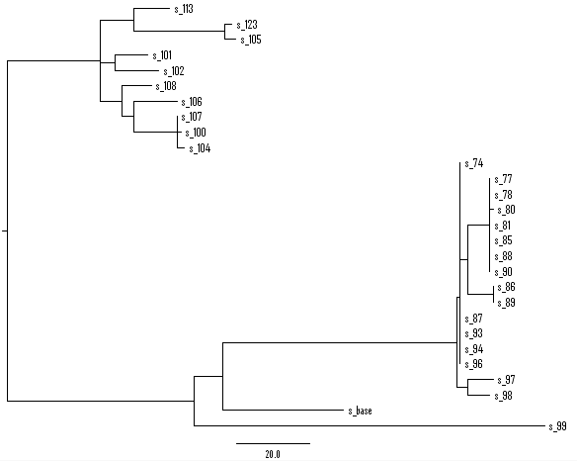
Chloroplast
27 samples + ref (28 accessions)
387 SNP sites (no indel, no heterozygous genotype, no N, at least 1 snp)
MP method
Tree length = 403
CI excluding uninformative characters = 0.9252
Notes:
Of 387 total characters:
All characters are of type 'unord'
All characters have equal weight
189 characters are parsimony-uninformative
Number of parsimony-informative characters = 198
Gaps are treated as "missing"
Character-state optimization: Accelerated transformation (ACCTRAN)
Tree number 1 (rooted using default outgroup)
Tree length = 403
Consistency index (CI) = 0.9603
Homoplasy index (HI) = 0.0397
CI excluding uninformative characters = 0.9252
HI excluding uninformative characters = 0.0748
Retention index (RI) = 0.9884
Rescaled consistency index (RC) = 0.9491

Slide 51
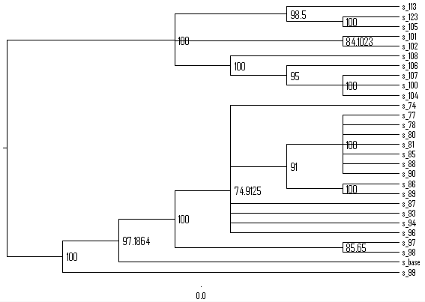
Chloroplast
27 samples + ref (28 accessions)
387 SNP sites (no indel, no heterozygous genotype, no N, at least 1 snp)
MP method, bootstrap
bootstrap nreps=200 treefile=boot.tre search=heuristic/ start=stepwise addseq=random nreps=10 swap=TBR;

Slide 52
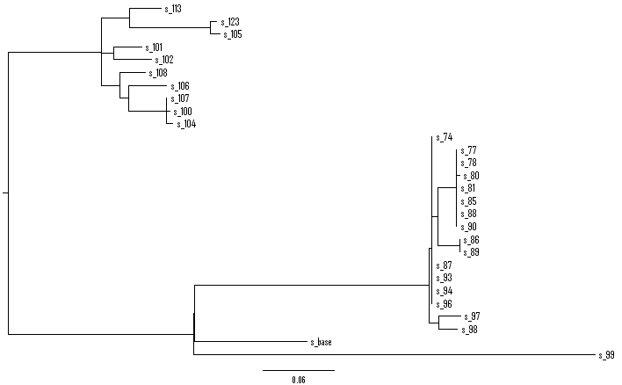
Chloroplast
27 samples + ref (28 accessions)
387 SNP sites (no indel, no heterozygous genotype, no N, at least 1 snp)
ML method
Notes:
paup> describetrees all/plot=phylogram
Tree description:
Unrooted tree(s) rooted using outgroup method
Optimality criterion = likelihood
Likelihood settings:
Number of substitution types = 2
Transition/transversion ratio estimated via ML
Assumed nucleotide frequencies (set by user):
A=0.25000 C=0.25000 G=0.25000 T=0.25000
Among-site rate variation:
Assumed proportion of invariable sites = none
Distribution of rates at variable sites = gamma (discrete approximation)
Shape parameter (alpha) = estimated
Number of rate categories = 4
Representation of average rate for each category = mean
These settings correspond to the K80(K2P)+G model
Number of distinct data patterns under this model = 61
Molecular clock not enforced
Starting branch lengths obtained using Rogers-Swofford approximation method
Branch-length optimization = one-dimensional Newton-Raphson with pass limit=20, delta=1e-06
-ln L (unconstrained) = 1784.63841
Tree number 1 (rooted using default outgroup)
-Ln likelihood = 2375.49578
Estimated ti/tv ratio = 0.512433 (kappa = 1.024865)
Estimated value of gamma shape parameter = infinity (all sites have a relative rate of 1.0)

Slide 53
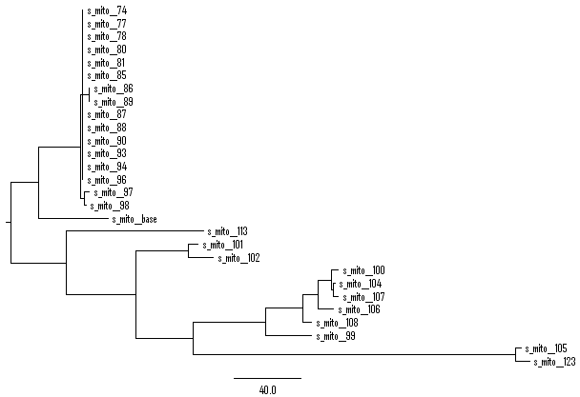
mitochondrial
27 samples + ref (28 accessions)
551 sites (no indel, no heterozygous genotype, no N)
MP method
Tree length = 652
CI excluding uninformative characters = 0.8124
Notes:
paup> describetrees 1 / Plot = Phylogram
Tree description:
Unrooted tree(s) rooted using outgroup method
Optimality criterion = parsimony
Character-status summary:
Of 551 total characters:
All characters are of type 'unord'
All characters have equal weight
150 characters are parsimony-uninformative
Number of parsimony-informative characters = 401
Gaps are treated as "missing"
Character-state optimization: Accelerated transformation (ACCTRAN)
Tree number 1 (rooted using default outgroup)
Tree length = 652
Consistency index (CI) = 0.8558
Homoplasy index (HI) = 0.1442
CI excluding uninformative characters = 0.8124
HI excluding uninformative characters = 0.1876
Retention index (RI) = 0.9355
Rescaled consistency index (RC) = 0.8006

Slide 54
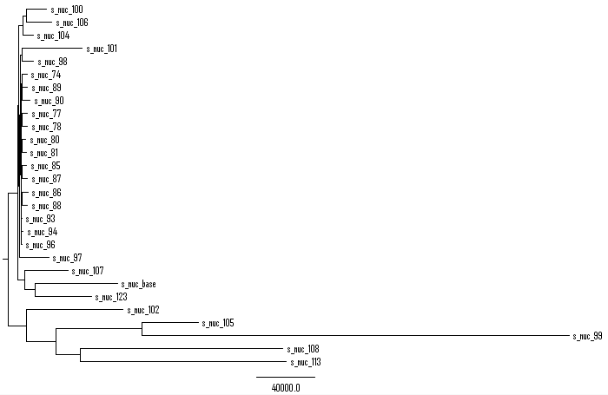
nuclear
27 samples + ref (28 accessions)
957609 sites (no indel, no heterozygous genotype, no N)
MP method
Tree length = 1075629
CI excluding uninformative characters = 0.6076
Notes:
describetrees 1 / Plot = Phylogram
Tree description:
Unrooted tree(s) rooted using outgroup method
Optimality criterion = parsimony
Character-status summary:
Of 957609 total characters:
All characters are of type 'unord'
All characters have equal weight
784192 characters are parsimony-uninformative
Number of parsimony-informative characters = 173417
Character-state optimization: Accelerated transformation (ACCTRAN)
Tree number 1 (rooted using default outgroup)
Tree length = 1075629
Consistency index (CI) = 0.8947
Homoplasy index (HI) = 0.1053
CI excluding uninformative characters = 0.6076
HI excluding uninformative characters = 0.3924
Retention index (RI) = 0.5810
Rescaled consistency index (RC) = 0.5198

Slide 55
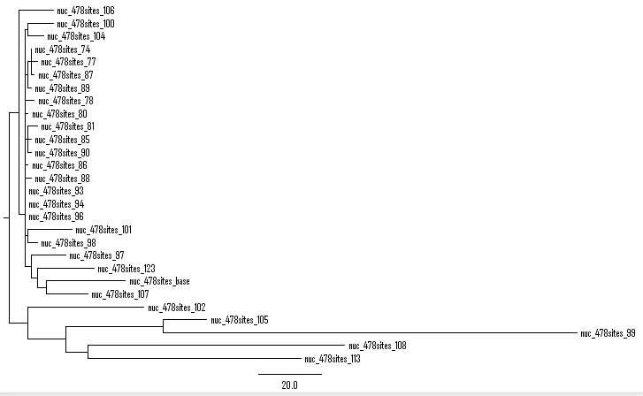
nuclear
27 samples + ref (28 accessions)
478 sites (no indel, no heterozygous genotype, no N, randomly selected sites)
MP method
Tree length = 527
CI excluding uninformative characters = 0.6418
Notes:
describetrees 1/plot=phylogram
Tree description:
Unrooted tree(s) rooted using outgroup method
Optimality criterion = parsimony
Character-status summary:
Of 478 total characters:
All characters are of type 'unord'
All characters have equal weight
393 characters are parsimony-uninformative
Number of parsimony-informative characters = 85
Gaps are treated as "missing"
Character-state optimization: Accelerated transformation (ACCTRAN)
Tree number 1 (rooted using default outgroup)
Tree length = 527
Consistency index (CI) = 0.9089
Homoplasy index (HI) = 0.0911
CI excluding uninformative characters = 0.6418
HI excluding uninformative characters = 0.3582
Retention index (RI) = 0.6800
Rescaled consistency index (RC) = 0.6181

Slide 56
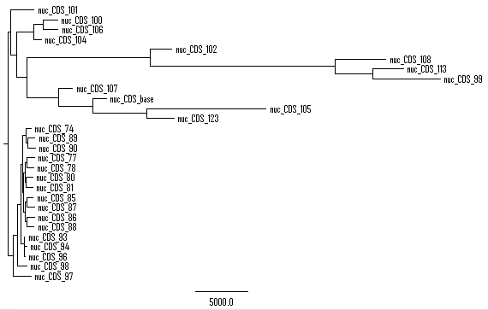
nuclear
27 samples + ref (28 accessions)
48439 sites (no indel, no heterozygous genotype, no N, minor Allele freq >= 3)
MP method
Tree length = 100260
CI excluding uninformative characters = 0.4836
Notes:
describetrees 1/plot=cladogram
Tree description:
Unrooted tree(s) rooted using outgroup method
Optimality criterion = parsimony
Character-status summary:
Of 48439 total characters:
All characters are of type 'unord'
All characters have equal weight
All characters are parsimony-informative
Character-state optimization: Accelerated transformation (ACCTRAN)
Tree number 1 (rooted using default outgroup)
Tree length = 100260
Consistency index (CI) = 0.4836
Homoplasy index (HI) = 0.5164
Retention index (RI) = 0.6399
Rescaled consistency index (RC) = 0.3095

Slide 57
Table 1. CI & RI of the MP-based trees
 | SNP sites | consistency index (CI) excluding uninformative characters | Retention index (RI)
Chloroplast | 387 | 0.93 | 0.99
Mitochondria | 551 | 0.81 | 0.94
Nuclear (MAF >= 3) | 48439 | 0.48 | 0.64

Slide 58
*
A
A*
A+AATAGT
AC
AG
A+G
A+GATT
A+GT
AT
A+T
A+TT
A+TTT
base
C
C+A
C+AT
CG
CT
C+T
G
G+A
G+C
G+CCAC
GT
G+T
N
T
T*
T+A
T+AA
T+AAA
T+C
T+G
T+TC
T+TTCAA
Possible genotypes
grep -v '*' temp-chloro | grep -v '+' | grep -v "[ACGT][ACGT][ACGT]*" | grep -v 'N' > apple-27sampbgi.chlorop.singleGeno.table
wc -l apple-27sampbgi.chlorop.singleGeno.table
### 108091 apple-27sampbgi.chlorop.singleGeno.table

Slide 59
cut -f 5 99.redu.pair.norm.sam | awk '$1 >= 20' | sort | uniq -c
10083
-----------------------------------
87 20
7 21
28 22
169 23
9 24
40 25
1 27
2963 29
2 33
118 36
379 37
2 40
2 41
12 43
36 46
6 48
10 50
6 52
8 54
20 55
52 57
6126 60
awk '$5 >= 20' 99.redu.pair.norm.sam | grep -o XM:i:[0-9]* | sort | uniq –c
10083
-----------------------------------
2498 XM:i:0
2149 XM:i:1
31 XM:i:10
31 XM:i:11
19 XM:i:12
14 XM:i:13
7 XM:i:14
6 XM:i:15
6 XM:i:16
4 XM:i:17
1 XM:i:18
1854 XM:i:2
1 XM:i:20
1 XM:i:21
1319 XM:i:3
920 XM:i:4
645 XM:i:5
288 XM:i:6
153 XM:i:7
91 XM:i:8
45 XM:i:9
1.20% (XM >= 10)

Slide 60

Notes:
awk 'NR > 19 && $5 >= 20' 99*sam | grep NM:i:6 | head (19 header lines in sam, mapQ>=20, )

Slide 62
Use bwa to map EST to 47 bZIP genes (alignment score > 30 corresponding to 30 consecutive matches).
Use blat to map ESTs to grape genome (mapping identity of full-length EST > 95%)
Use blat to map bZIP genes to grape genome
EST and one bZIP gene mapped to the same locus (same chr, overlapped)
cut -f 1,3 est.vitis.feb2014.mapped.overlapped.sam | sort | uniq | cut -f 2 | sort | uniq -c > out # one EST for one bZIP gene; # of ESTs supporting bZIP gene
samtools mpileup -Q 0 -d 1000000 -f bZIP est.vitis.feb2014.mapped.overlapped.sorted.bam > est.vitis.feb2014.mapped.overlapped.sorted.pileup
cut -f 1 est.vitis.feb2014.mapped.overlapped.sorted.pileup | uniq -c

Slide 63
Raw reads (151bp).
Insert size: 208.967 +/- 53.169
 | Read length | Aln param | Read # | Mapped reads |  | Uniq. Reads |  | Uniq. & non-dup. |  | Usable base pairs
Raw reads | 151(bp) | -n 6 -o 2 -e 2 | 6592031 | 3397424 | 51.54% | 2,965,127 | 44.98% | 2,695,369 | 40.89% | 407,000,719
Cleaned reads | 100 – 151bp | -n 4 -o 1 -e 2 | 5800442 | 4067662 | 70.13% | 3,614,269 | 62.31% |  |  | 518,369,280
Cleaned reads (Honghe’s script):
removed duplicated pair,
trimmed low quality base pairs at both ends of a read,
trimmed adaptor & barcode at 3’ end,
only kept reads >= 100 bp which are still paired (single / pair = 4%)
LL15_ATCACG_1st_R1.fastq, EMS mutation

Slide 64
RNA-seq C3309Root-25-2009.clean.fa (field sample)
Strand specific (some of the other libraries are not SS)
101bp
Tophat2 parameters:
--library-type fr-firststrand
--segment-mismatches 1
--read-mismatches 3
--read-edit-dist 3
--max-multihits 20
--segment-length 25
-G ../V1.phase.gff3
--max-intron-length 5000
--max-segment-intron 5000
Use Yi’s scripts to calculate raw counts and RPKM

Slide 65
 | Gff file provided, --max-intron-length 5,000 | Gff file not provided, --max-intron-length 500,000
rRNA cleaned reads | 43,093,619 | 43,093,619
Mapped | 32,000,263 (74.3% ) | 31,861,372 (73.9% )
Reads have multiple alignments | 2,319,373 (848 have >20 alignments) | 3,431,716 (11991 have >20 alignments)

Slide 66
 | rRNA (%) | cleaned reads | mapped reads | mapped % | reads have multiple alignments | multi align % | reads have > 20 align
C3309Root-25-2009.clean | 5.41% | 43,093,619 | 32,000,263 | 74.26% | 2,319,373 | 5.38% | 848
C3309Root-35-2009.clean | 4.87% | 48,390,939 | 35,312,990 | 72.97% | 2,995,878 | 6.19% | 7665
CabSavBuds-2535-2008.clean | 2.45% | 52,573,923 | 47,170,355 | 89.72% | 2,586,638 | 4.92% | 283
CabSavLeaf-25-2009.clean | 2.78% | 45,186,967 | 40,712,244 | 90.10% | 2,508,951 | 5.55% | 169
CabSavLeaf-25-2009.c2 | s | cabsauv | c3309 | field | Jun-09 | treated soil, pH 6

Slide 67
Effects of gff3 file and intron length on 1 million reads
==> temp.1m/align_summary.txt <==
Reads:
Input: 1000000
Mapped: 740367 (74.0% of input)
of these: 75494 (10.2%) have multiple alignments (126 have >20)
74.0% overall read alignment rate.
==> temp.1m.gff3/align_summary.txt <==
Reads:
Input: 1000000
Mapped: 761384 (76.1% of input)
of these: 55686 ( 7.3%) have multiple alignments (25 have >20)
76.1% overall read alignment rate.
==> temp.1m.gff3.intron-5k/align_summary.txt <==
Reads:
Input: 1000000
Mapped: 755572 (75.6% of input)
of these: 54509 ( 7.2%) have multiple alignments (20 have >20)
75.6% overall read alignment rate.

Slide 68
24 grape grafting RNA-seq libraries
library | library type | read len. | map param. | rRNA (%) | cleaned reads | mapped reads | mapped %
C3309Root-25-2009.clean | strand specific | 101bp | -n 3 | 5.41% | 43,093,619 | 32,000,263 | 74.26%
C3309Root-35-2009.clean | strand specific | 101bp | -n 3 | 4.87% | 48,390,939 | 35,312,990 | 72.97%
CabSavBuds-2535-2008.clean | strand specific | 101bp | -n 3 | 2.45% | 52,573,923 | 47,170,355 | 89.72%
CabSavLeaf-25-2009.clean | strand specific | 101bp | -n 3 | 2.78% | 45,186,967 | 40,712,244 | 90.10%
CabSavLeaf-2535-2008.clean | strand specific | 101bp | -n 3 | 4.48% | 47,903,490 | 42,504,296 | 88.73%
CabSavLeaf-35-2009.clean | strand specific | 101bp | -n 3 | 3.18% | 53,527,610 | 47,624,338 | 88.97%
P1.clean | strand specific | 100bp | -n 3 | 0.76% | 45,088,317 | 37,194,621 | 82.49%
P10.clean | strand specific | 100bp | -n 3 | 0.81% | 57,038,744 | 47,940,840 | 84.05%
P11.clean | strand specific | 100bp | -n 3 | 0.68% | 32,316,382 | 27,037,530 | 83.67%
P12.clean | strand specific | 100bp | -n 3 | 0.78% | 50,565,379 | 41,914,353 | 82.89%
P13.clean | strand specific | 100bp | -n 3 | 0.52% | 75,481,881 | 62,568,214 | 82.89%
P14.clean | strand specific | 100bp | -n 3 | 0.61% | 47,721,394 | 39,398,526 | 82.56%
P15.clean | strand specific | 100bp | -n 3 | 1.17% | 45,114,888 | 40,735,991 | 90.29%
P16.clean | strand specific | 100bp | -n 3 | 1.26% | 49,457,961 | 44,640,671 | 90.26%
P17.clean | strand specific | 100bp | -n 3 | 1.11% | 41,537,087 | 37,100,247 | 89.32%
P18.clean | strand specific | 100bp | -n 3 | 1.89% | 43,284,573 | 38,782,238 | 89.60%
P2.clean | strand specific | 100bp | -n 3 | 0.51% | 47,132,511 | 38,912,702 | 82.56%
P3.clean | strand specific | 100bp | -n 3 | 0.83% | 60,145,272 | 49,329,041 | 82.02%
P4.clean | strand specific | 100bp | -n 3 | 0.85% | 59,960,331 | 49,522,950 | 82.59%
P7.clean | strand specific | 100bp | -n 3 | 1.13% | 27,892,036 | 23,601,233 | 84.62%
P8.clean | strand specific | 100bp | -n 3 | 0.69% | 37,065,682 | 31,478,431 | 84.93%
P9.clean | strand specific | 100bp | -n 3 | 1.05% | 49,985,442 | 42,210,064 | 84.44%
s_4.clean | non specific | 44bp | -n 1 | 5.20% | 11,976,831 | 10,354,828 | 86.46%
s_6.clean | non specific | 44bp | -n 1 | 4.81% | 9,449,639 | 8,079,223 | 85.50%
Gene co-expression network?

Slide 69
5 additional grape grafting RNA-seq libraries
library | library type | read len. | map param. | rRNA (%) | cleaned reads | mapped reads | mapped %
23R | strand specific | 101bp | -n 3 | 0.69% | 46,673,497 | 36,249,809 | 77.67%
23S | strand specific | 101bp | -n 3 | 3.65% | 6,139,997 | 5,382,411 | 87.66%
31R | strand specific | 101bp | -n 3 | 1.16% | 40,089,293 | 28,487,606 | 71.06%
31S | strand specific | 101bp | -n 3 | 2.69% | 6,537,962 | 5,846,989 | 89.43%
riesling | strand specific | 101bp | -n 3 | 3.72% | 11,937,702 | 10,718,556 | 89.79%
Gene co-expression network?

Slide 70
384_4423_3880_N_P4_TGACCA_R1.fastq.gz unexpected end of file
61,003,589 -> 60,474,016 reads (lost 1% reads)

Slide 71
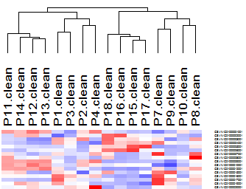
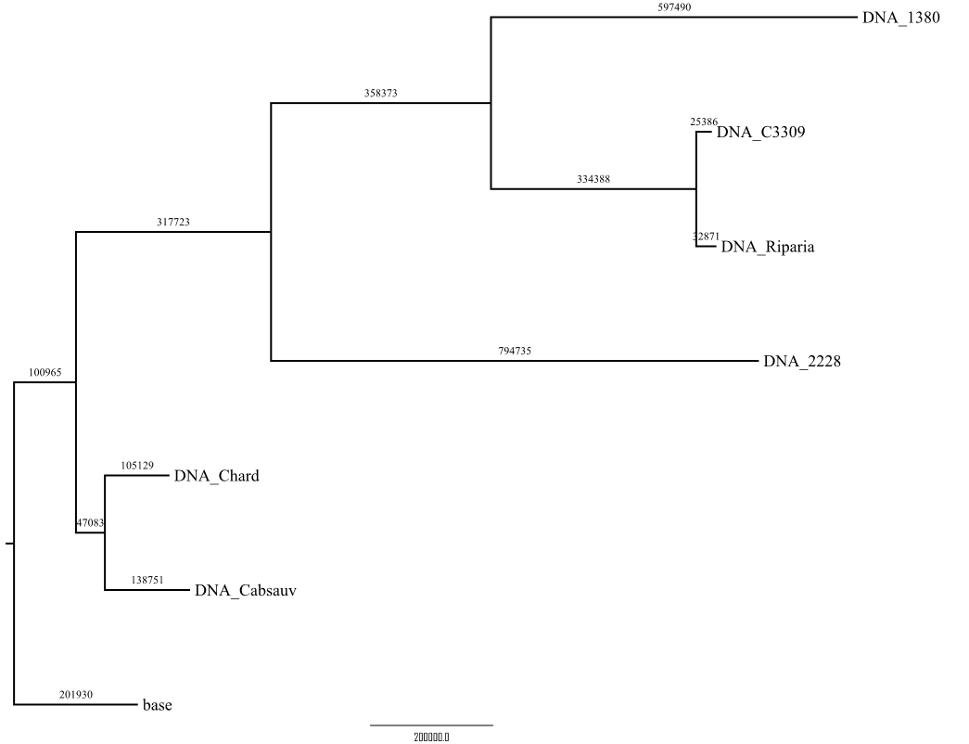
Id | s/r | scion | rootstock | culture/field | time
P1.c2 | s | 1380 | 2228 | culture | 2 weeks
P3.c2 | s | 1380 | 2228 | culture | 4 weeks
P2.c2 | r | 2228 | 1380 | culture | 2 weeks
P4.c2 | r | 2228 | 1380 | culture | 4 weeks
P12.c2 | r | chard | c3309 | culture | 30 days
P13.c2 | r | chard | ripar | culture | 20 days
P14.c2 | r | chard | ripar | culture | 30 days
P11.c2 | r | chard | c3309 | culture | 20 days
P7.c2 | s | 2228 | 1380 | culture | 2 weeks
P9.c2 | s | 2228 | 1380 | culture | 4 weeks
P8.c2 | r | 1380 | 2228 | culture | 2 weeks
P10.c2 | r | 1380 | 2228 | culture | 4 weeks
P17.c2 | s | chard | ripar | culture | 20 days
P15.c2 | s | chard | c3309 | culture | 20 days
P16.c2 | s | chard | c3309 | culture | 30 days
P18.c2 | s | chard | ripar | culture | 30 days
Raw RPKM for cor() calc.
P1 P3 P2 P4
P1 1.0000000 0.8445623 0.6829887 0.5488747
P3 0.8445623 1.0000000 0.7476332 0.6295954
P2 0.6829887 0.7476332 1.0000000 0.8835926
P4 0.5488747 0.6295954 0.8835926 1.0000000
Standardize rows for clustering
Notes:
P1 P3 P2 P4
P1 1.0000000 0.8445623 0.6829887 0.5488747
P3 0.8445623 1.0000000 0.7476332 0.6295954
P2 0.6829887 0.7476332 1.0000000 0.8835926
P4 0.5488747 0.6295954 0.8835926 1.0000000

Slide 72
2761413 SNPs

Slide 73
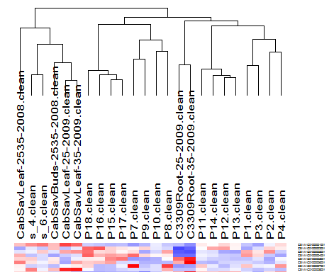
Id | s/r | scion | rootstock | culture/field | time
P1.c2 | s | 1380 | 2228 | culture | 2 weeks
P3.c2 | s | 1380 | 2228 | culture | 4 weeks
P2.c2 | r | 2228 | 1380 | culture | 2 weeks
P4.c2 | r | 2228 | 1380 | culture | 4 weeks
P12.c2 | r | chard | c3309 | culture | 30 days
P13.c2 | r | chard | ripar | culture | 20 days
P14.c2 | r | chard | ripar | culture | 30 days
P11.c2 | r | chard | c3309 | culture | 20 days
P7.c2 | s | 2228 | 1380 | culture | 2 weeks
P9.c2 | s | 2228 | 1380 | culture | 4 weeks
P8.c2 | r | 1380 | 2228 | culture | 2 weeks
P10.c2 | r | 1380 | 2228 | culture | 4 weeks
P17.c2 | s | chard | ripar | culture | 20 days
P15.c2 | s | chard | c3309 | culture | 20 days
P16.c2 | s | chard | c3309 | culture | 30 days
P18.c2 | s | chard | ripar | culture | 30 days
26346 genes
Standardize rows
Average linking (centroid similar clustering)

Slide 74
abnormal RP
normal RP
left anchoring window
right anchoring window
reference
left anchoring window
right anchoring window
C
reference
C
C
T
T
T
T
T
T
Supplementary figure 1: Normal-abnormal-read-ratio & SNP filter

Slide 75
left anchoring window
right anchoring window
reference
left breakpoint
right breakpoint
reference

Slide 76
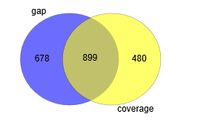
Deletion by Pindel: 21 kept
Heinz vs. heinz; 2078 deletions; 21 kept; coverage (40%)

Slide 77
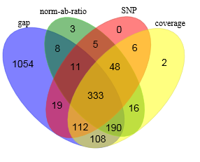
Deletion by Pindel: 21 kept
Deletion by SVDetect: 8 kept

Slide 78
linyong@boyce:Heinz_gDNA$ head -3 temp (changed to name overlap-0d8-svdetect-pindel-del )
svdetect SL2.40ch03 9536207 9536317 pindel SL2.40ch03 9536182 9536318
svdetect SL2.40ch04 5071512 5071678 pindel SL2.40ch04 5071483 5071647
svdetect SL2.40ch04 5071512 5071678 pindel SL2.40ch04 5071485 5071647
linyong@boyce:Heinz_gDNA$ cut -f 1-4 temp | sort | uniq | wc -l
520
linyong@boyce:Heinz_gDNA$ cut -f 5-8 temp | sort | uniq | wc -l
594
linyong@boyce:Heinz_gDNA$ wc -l temp
598 temp
Heinz:
temp: 520 SVDetect deletions significantly overlapped with 594 pindel deletions (overlapping by > 80%)
518 SVDetect deletions removed by at least 1 of the 4 filters. Two remained
SL2.40ch05 61121538 61126398
SL2.40ch09 43584604 43584985
592 pindel deletions removed by at least 1 of the 2 filters. Two remained
SL2.40ch05 61121526 61126398
SL2.40ch09 43584602 43584987
Notes:
cat van-d-normRatio.txt van-d-N.txt van-d-pileup.txt van-d-snp.txt | sort | uniq | awk 'BEGIN{FS = "-"; OFS = "\t"} {print $1, $3, $5}' > temp-svd-del-all-filtered
cat van-d-N.pindel.txt van-d-pileup.40perc.pindel.txt | sort | uniq | awk 'BEGIN{FS = "-"; OFS = "\t"} {print $1, $3, $5}' > temp-pindel-del-all-filtered
cut -f 5-8 temp | sort | uniq > temp-overlap-pindel
cat ../temp-overlap-pindel | cut -f 2-4 | while read s; do grep "$s$" temp-pindel-del-all-filtered | head -1; done | wc -l
592

Slide 79
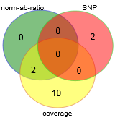

Figure 4. 308 ‘true’ deletions. 47 false deletions. Wild vs. cultivated cucumber
Deletion: 294 kept
Deletion: 7 kept
The FDR for the data set consisting of these true and false deletions is 13%.
For the 308 true deletions. 14 (4.5%) were removed altogether by the three filters (norm-ab-ratio, SNP, coverage filter).
For the 47 false deletions, 40 (85%) were removed. Thus, after filtering, FDR was improved from 13% to 2.3% (7 / (7 + 294) ).
Changed coverage filter parameter from 80% to 15%. Update all figures that use the coverage filter.

Slide 80
Wwz server
$ t=`ls *WAAXX*_1.fq.clean.dup.clean`
$ echo $t
081203_I328_FC30DFWAAXX_L6_WATzhyDAADEAAPE_1.fq.clean.dup.clean 081203_I328_FC30DFWAAXX_L7_WATzhyDAADEAAPE_1.fq.clean.dup.clean 081203_I328_FC30DFWAAXX_L8_WATzhyDAADEAAPE_1.fq.clean.dup.clean
$ cat $t > WAAXX.3lib-1.dup.clean
$ t=`ls *WAAXX*_2.fq.clean.dup.clean`
$ echo "$t"
081203_I328_FC30DFWAAXX_L6_WATzhyDAADEAAPE_2.fq.clean.dup.clean
081203_I328_FC30DFWAAXX_L7_WATzhyDAADEAAPE_2.fq.clean.dup.clean
081203_I328_FC30DFWAAXX_L8_WATzhyDAADEAAPE_2.fq.clean.dup.clean
$ cat $t > WAAXX.3lib-2.dup.clean
$ wc -l WAAXX*
85576020 WAAXX.3lib-1.dup.clean
85576020 WAAXX.3lib-2.dup.clean
171152040 total
$ bwa aln -t 10 -n 2 -o 1 -e 1 -f WAAXX.3lib.R1.sai /home/linyong/watermelon-102acc/watermelon_v1.genome WAAXX.3lib-1.dup.clean

